Slide 1
An Entirely New Drone 3D Mapping System
By Marc van Zyl

Slide 2
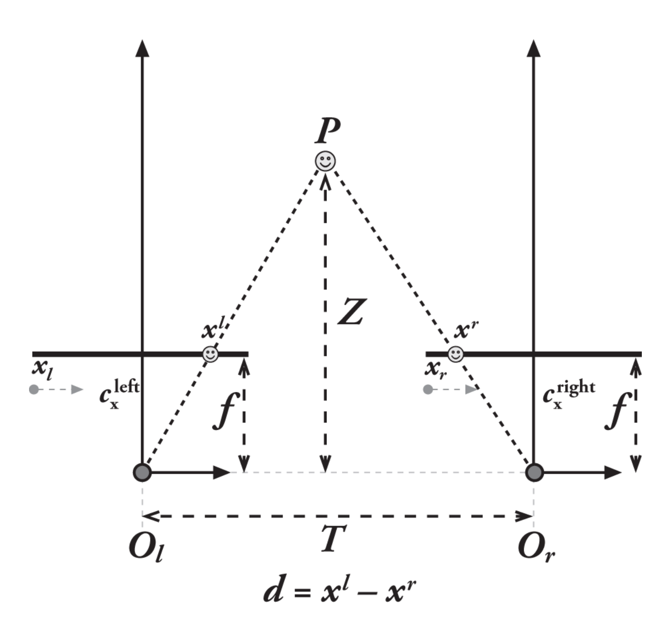
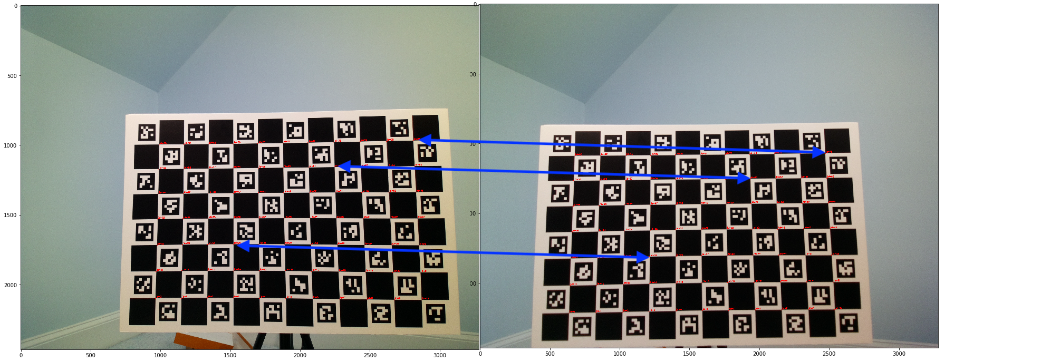
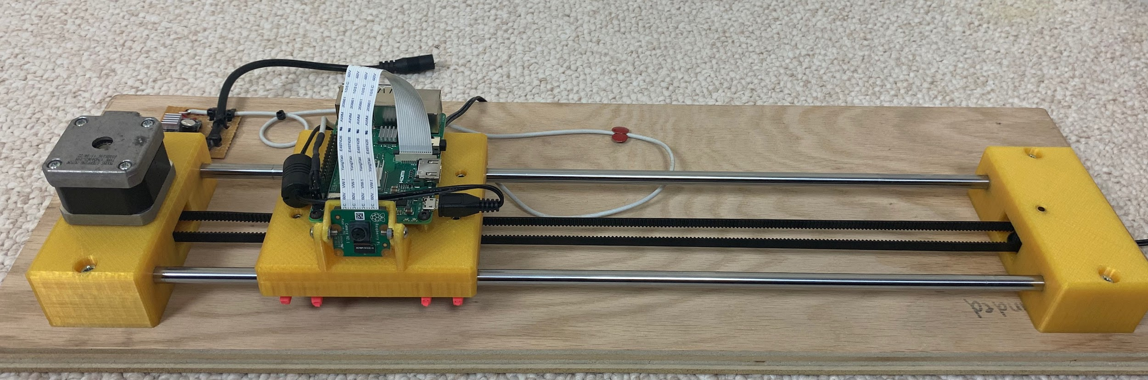
What am I doing?!?!?!
Current Stereo Vision
2 Cameras side by side
Gets less accurate over time
Optical Flow
1 Moving Camera
Accurate forever
Less computationally intensive
Instant room mapping

Slide 3
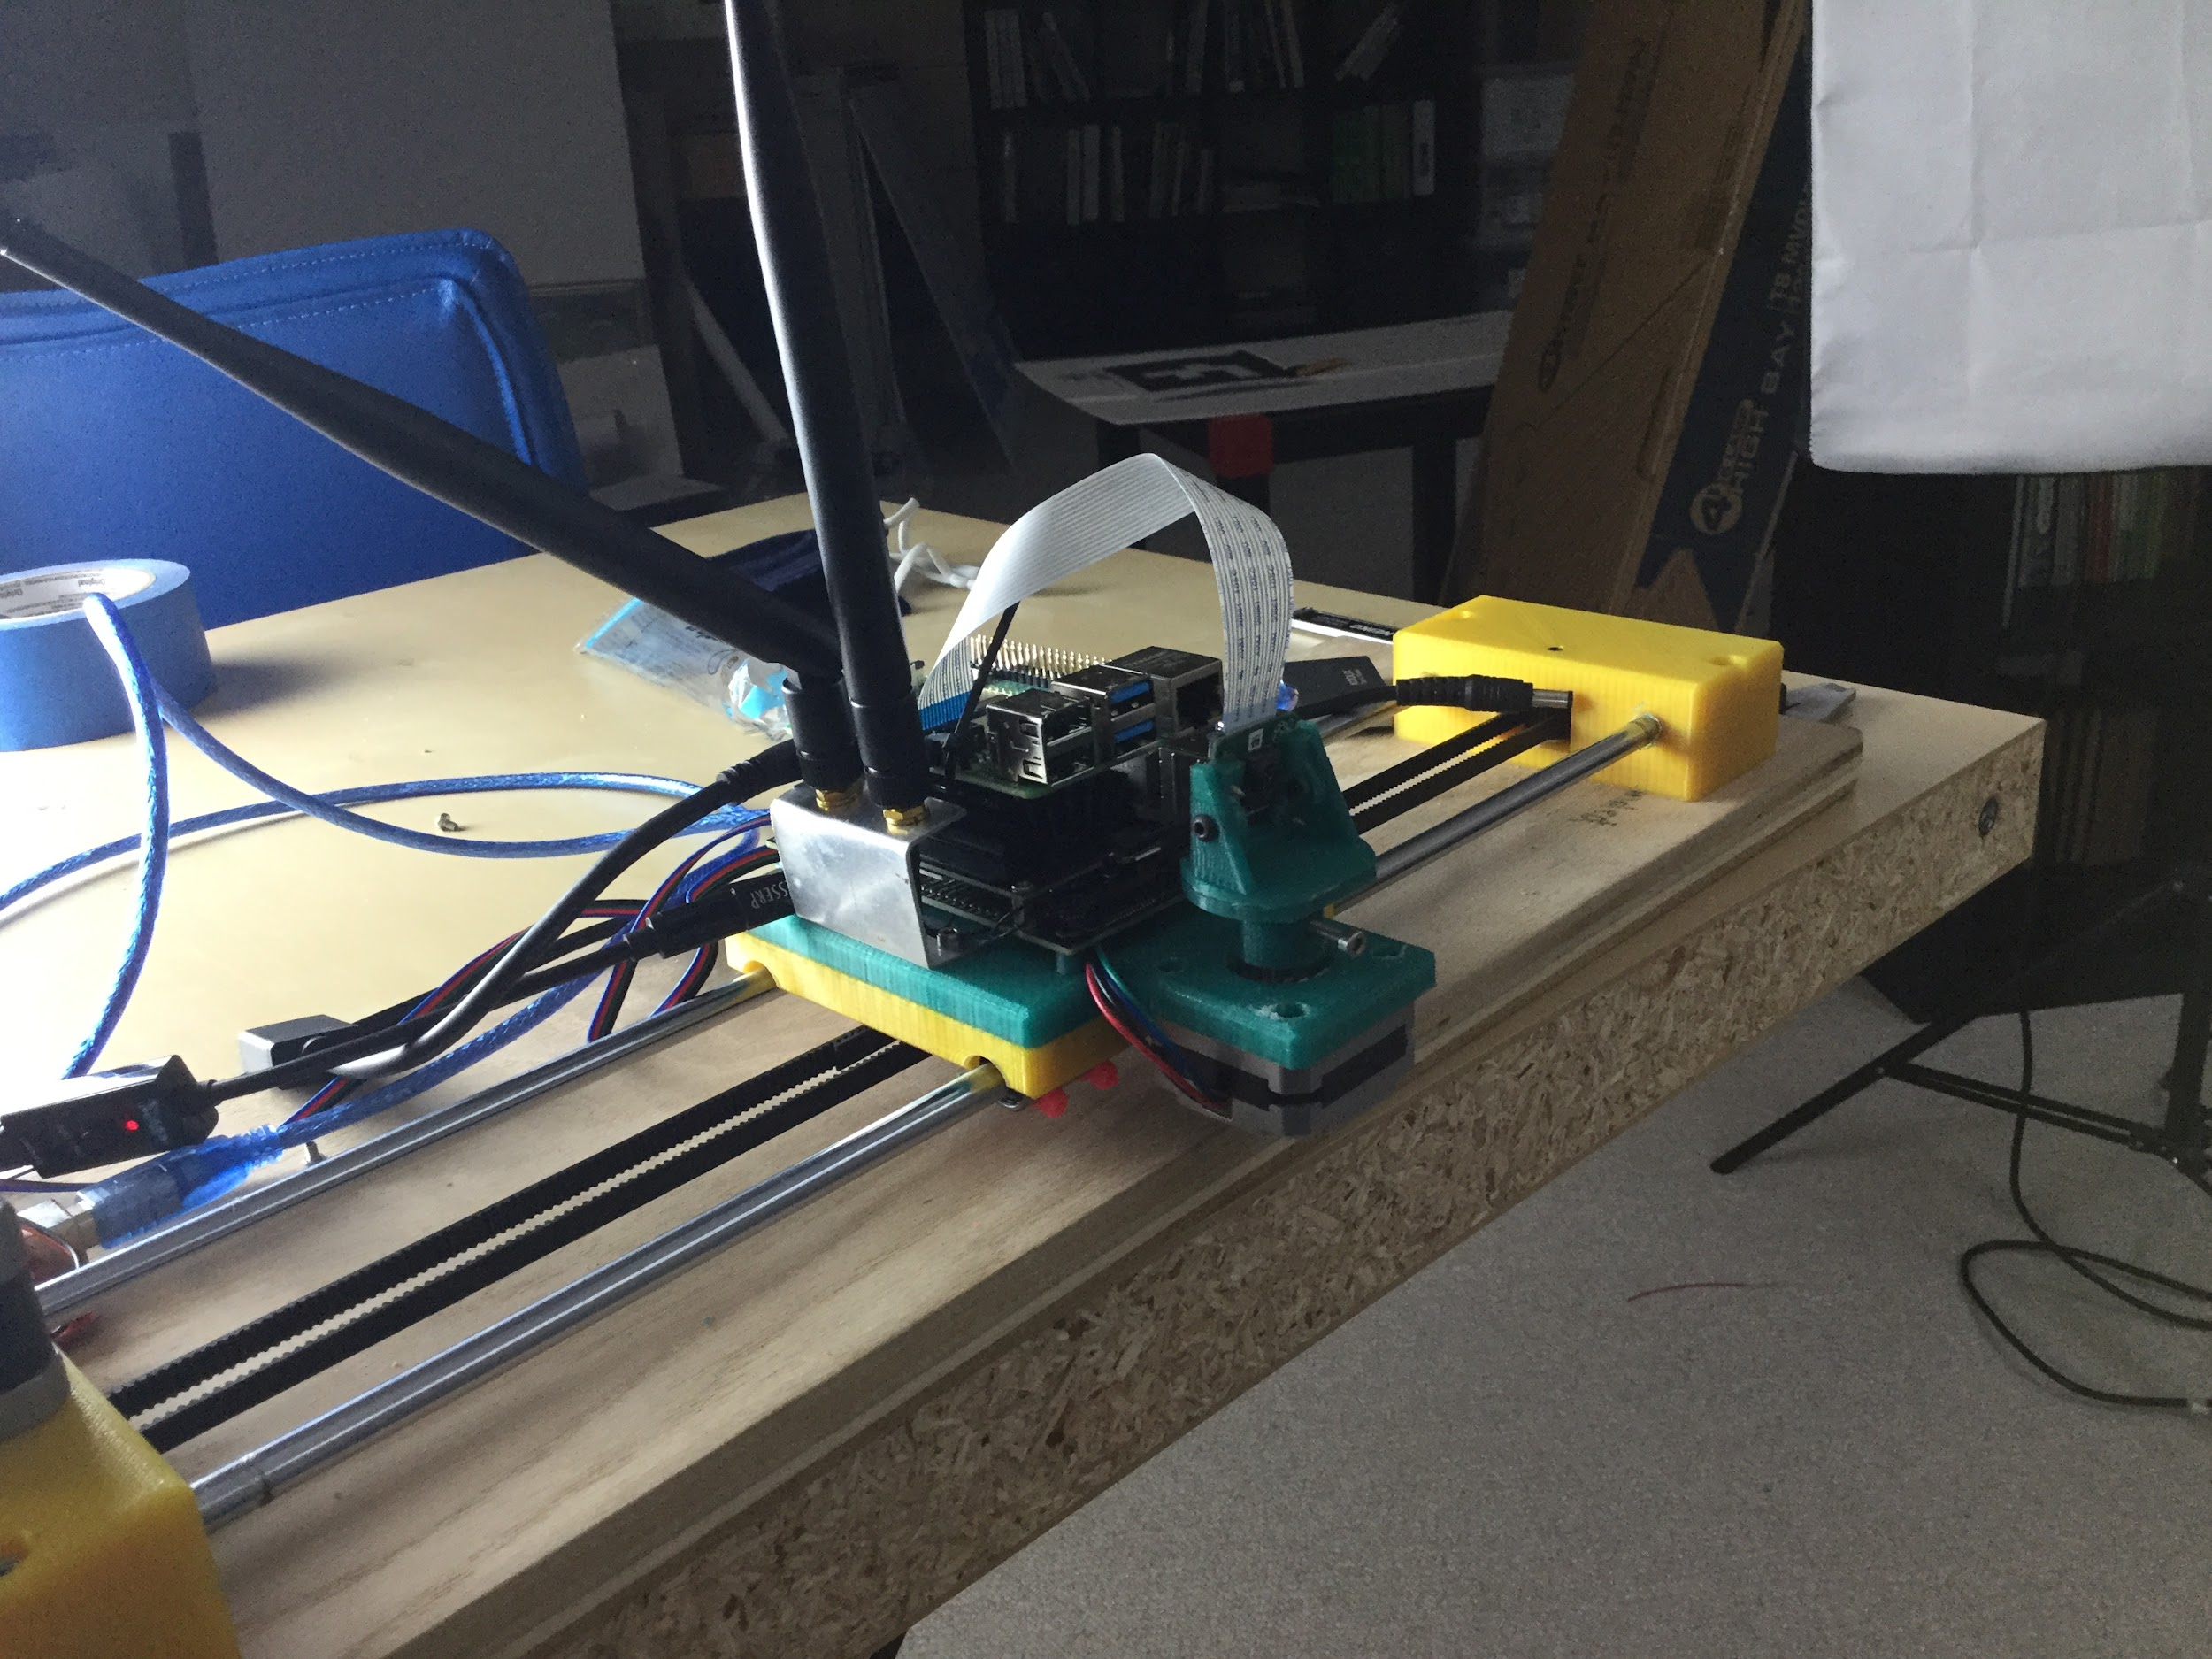
This year vs Last year
Last year
Completely Linear
Stereo vs. OF
This year
Rotation added
Different types of OF (eventually)

Slide 4
Done
Jetson Nano microprocessor for video
Lack of central documentation on Gstreamer
Calibration
Setting the Scene
Added rotation
Collected data

Slide 5
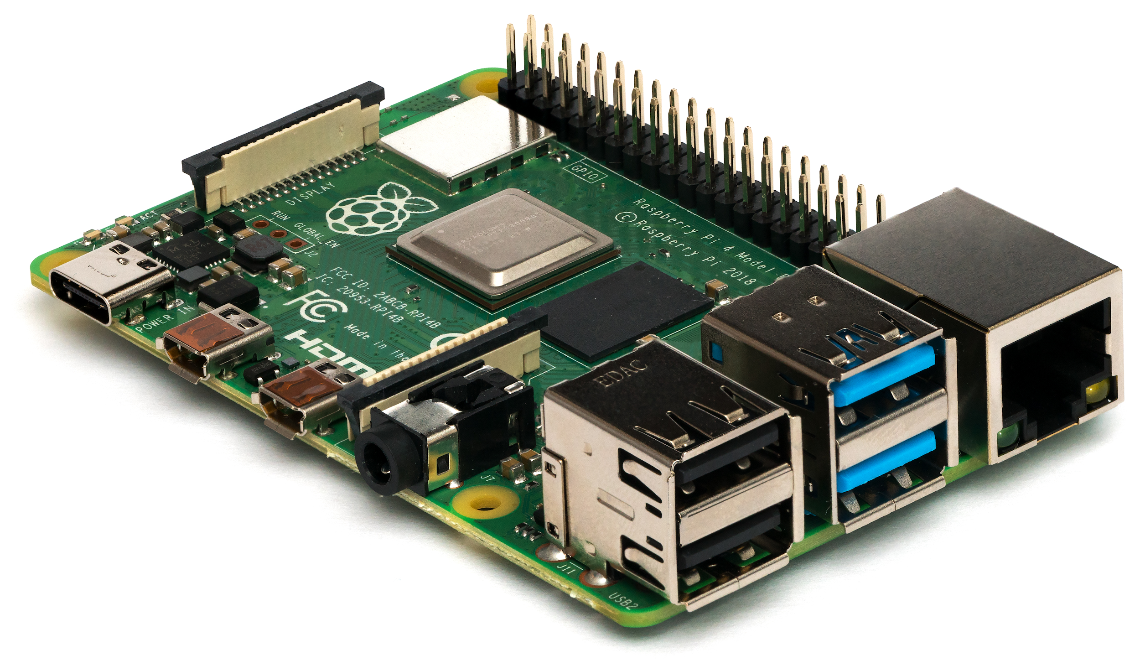
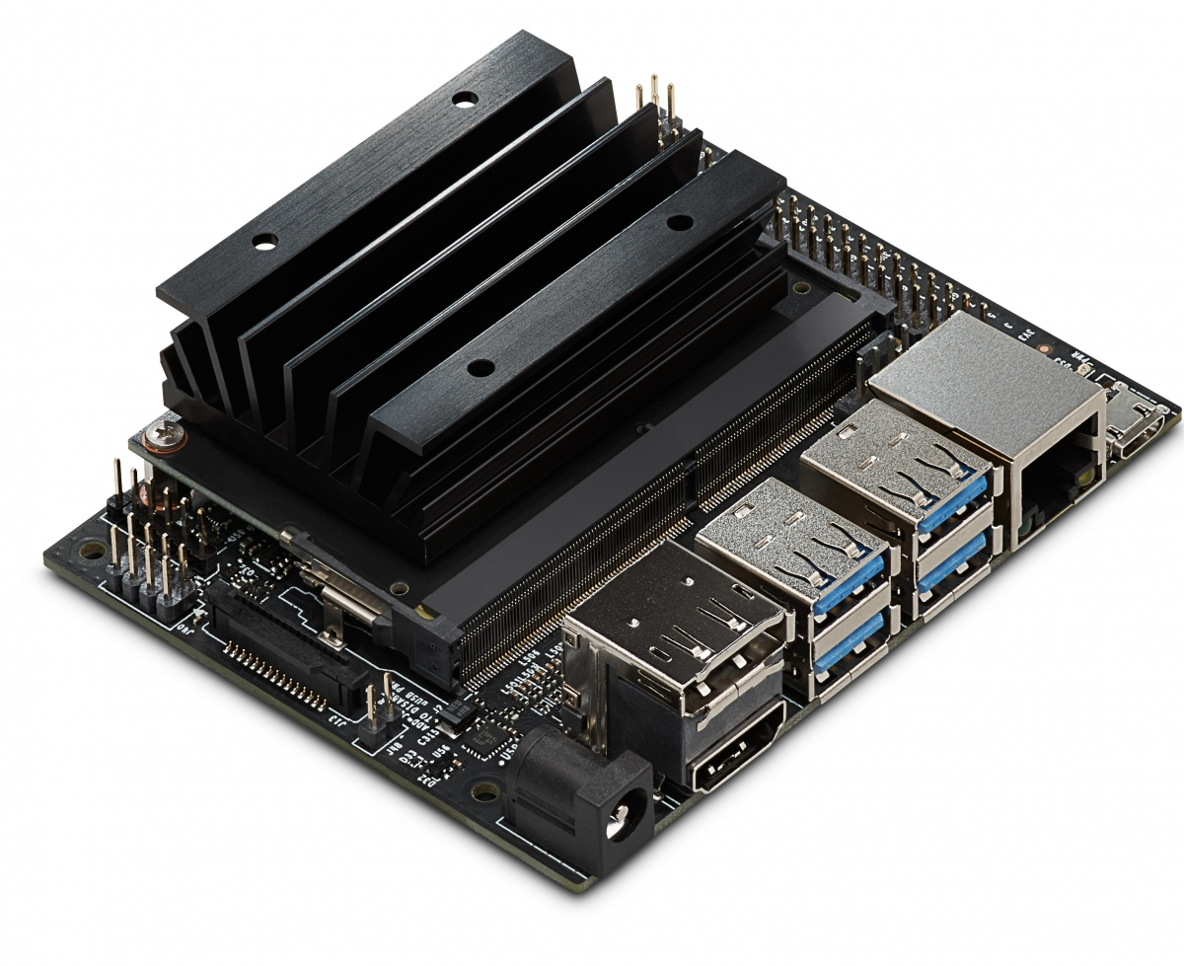
Jetson Nano
Allows for high quality video
Previously, I put images together to make video
Distance Determination

Slide 6
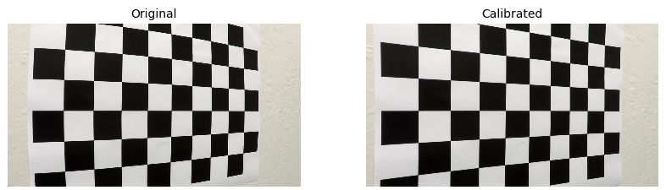
Calibration
Problems with Jetson pictures

Slide 7
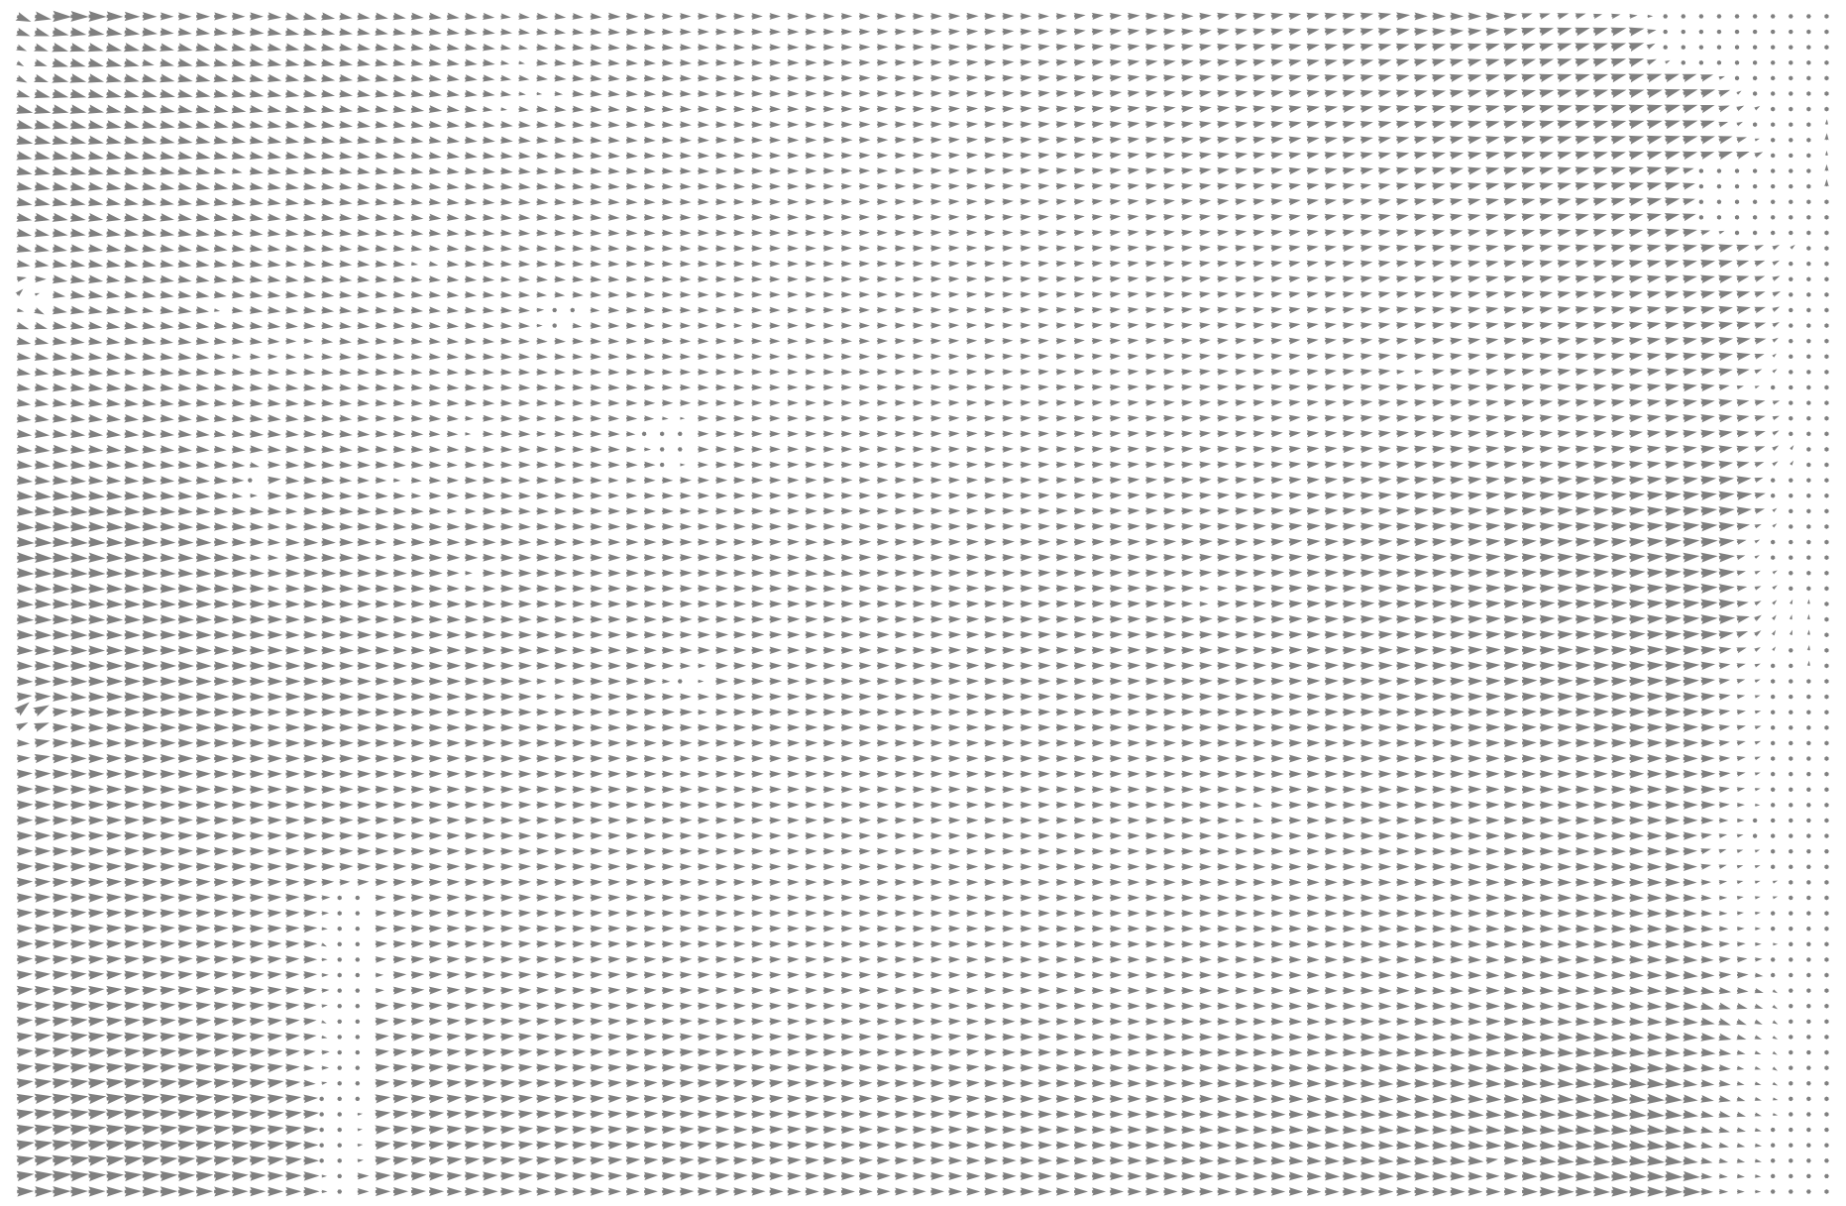

Slide 8
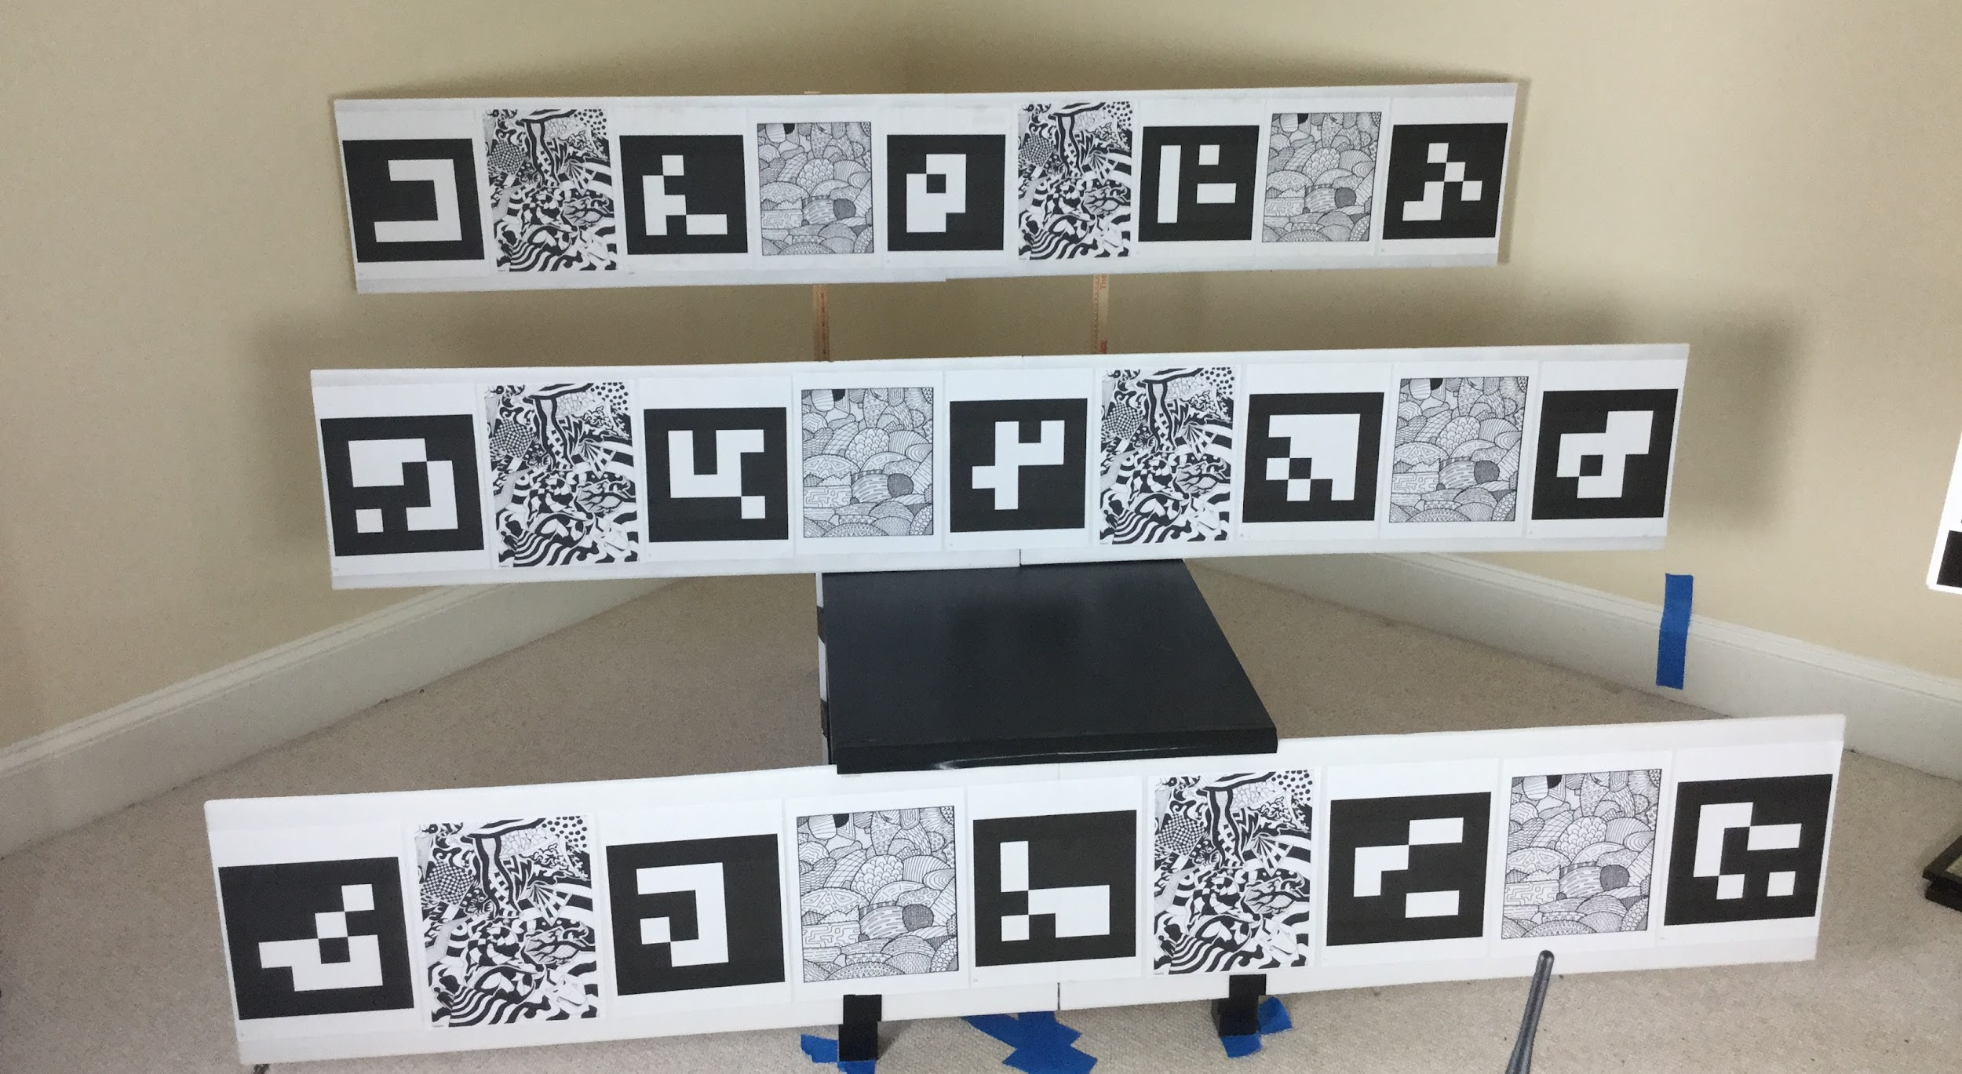
Setup

Slide 9
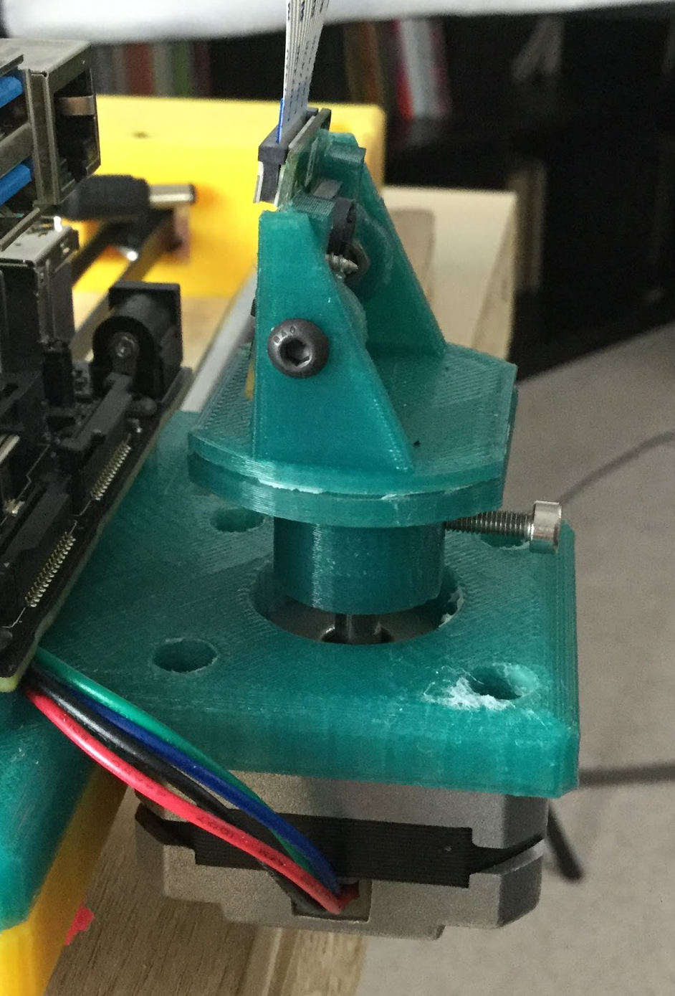
Rotation
Massive amounts of code
New stepper motor driver required

Slide 10
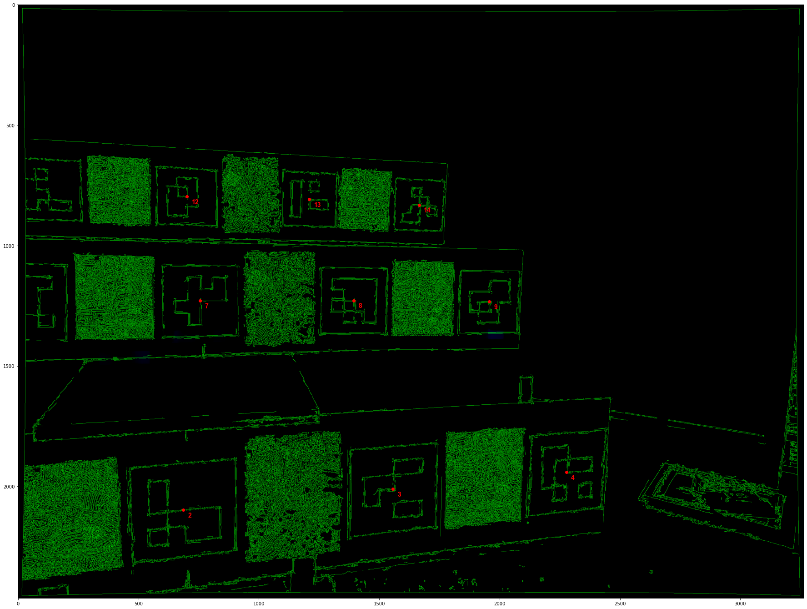
Data
Videos with different slide and rotation speeds

Slide 11
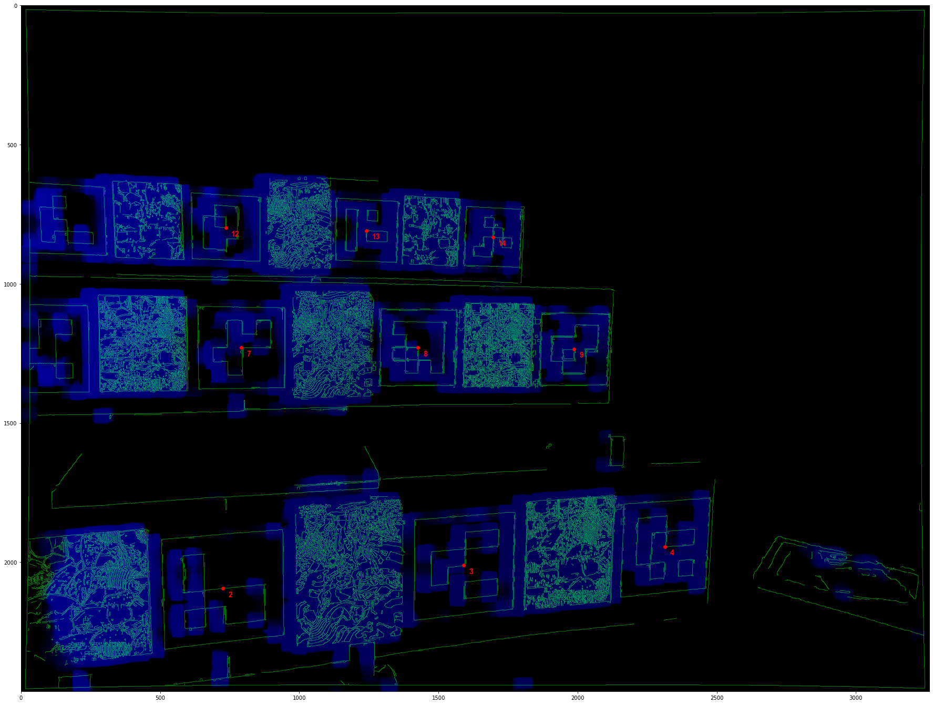
Some preliminary analysis

Slide 12
Next steps
Stereo data
Run calibration software
Find actual distances to objects

